Slide 1
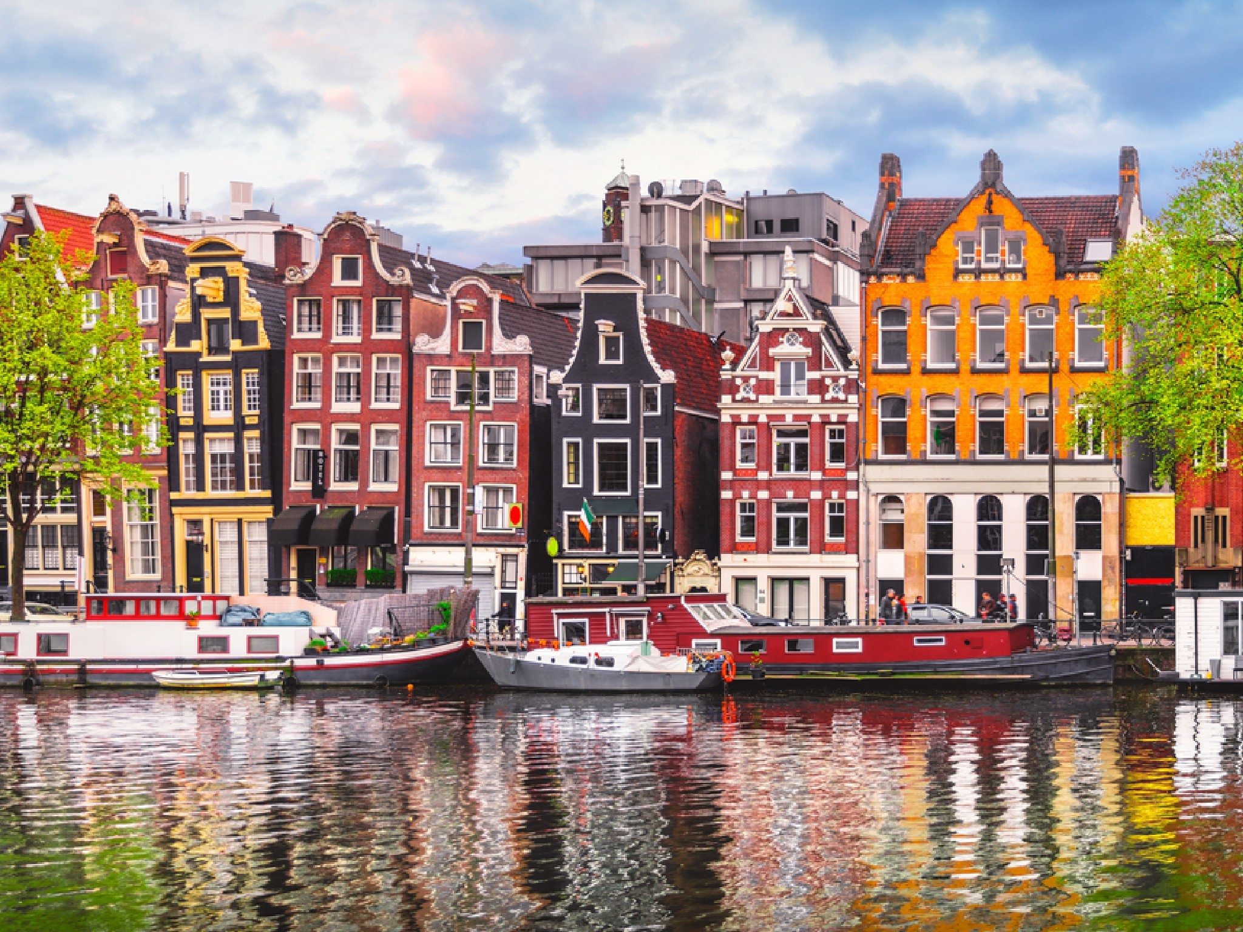
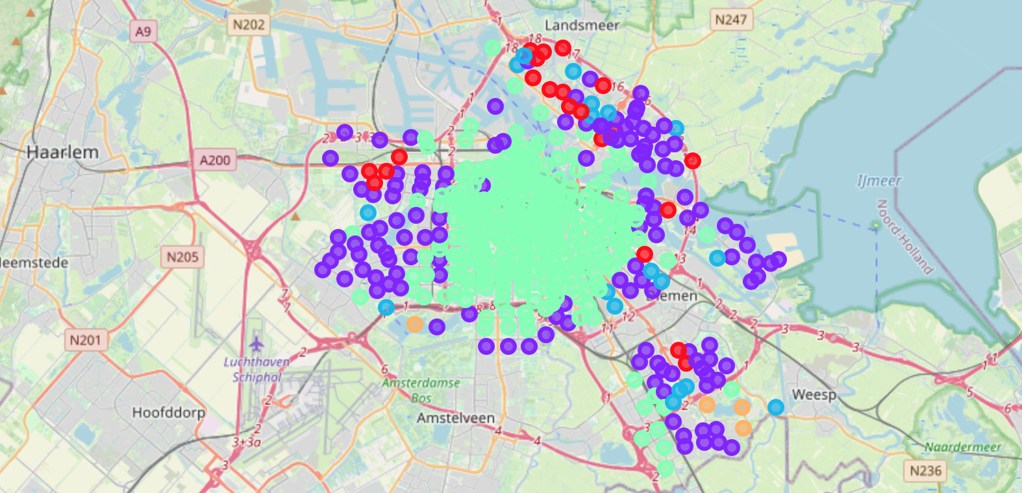
IBM Coursera CAPSTONE PROJECT
AnCA VINTILA
OCTOBER 2020
Best Amsterdam’s Neighborhoods for families with children

Slide 2

Introduction/ Business Problem
Data
Methodology
Results
Discussion
Conclusion
References and acknowledgment

Slide 3
Introduction/business problem
Identify residential neighborhoods in Amsterdam, Netherlands that are suitable for families with children.
Families willing to move from abroad or even from the country or the city or
the ones interested in a real estate property should have an understanding of the areas of Amsterdam so they would chose the best option for them using the recommendation of this data science project.

Slide 4
DATA
Amsterdam data related to the Boroughs/Neighborhoods
The corresponding geographical coordinates latitude and longitude of each Boroughs/Neighborhoods
Source of Data:
Wikipedia
Official Amsterdam Municipality data from their website : https://data.amsterdam.nl/
Foursquare API

Slide 5
METHODOLOGY
Collect the data found on Wikipedia/Amsterdam Municipality API regarding the Amsterdam’s boroughs and neighborhoods including the geographical coordinates and store it into Pandas data frames.
Use Foursquare API to explore the neighborhoods- pass the geographical coordinates of each neighborhood to the API, which returned a list of venues in the neighborhood within 500 meters radius and a limit of maximum 100 venues per neighborhood. The resulting dataset became a list of all neighborhoods with added venues and venue categories.
Prepare the dataset for analysis -use one hot encoding to pivot venue categories from rows to columns and calculate the mean of the frequency of occurrence of each category.
Perform clustering- run the k-means clustering algorithm on the prepared data to derive 5 clusters of neighborhoods.

Slide 6
RESULTS
Cluster 0: Suburbs : bus stops, fast food restaurants, farmers market, supermarkets which all suggests places where one can find something quick to eat maybe places inside malls which suggest residential areas.
Cluster 1: Residential: coffee shops and restaurants as well as parks and sporting venues which is all suitable for families.
Cluster 2: Soccer Field: most popular venue category is the Soccer Field, followed by fast food restaurants, sport shops which indicate this cluster is very specific to soccer field areas
Cluster 3: Downtown: popular venues like restaurants, coffee shops, cafes, bars, bakeries so this indicates this is the downtown area with popular places for going out activities.
Cluster 4: Harbor: harbor, zoo, exhibitions, fast food restaurants and also parks so seems also an interesting green area suited for families.

Slide 7
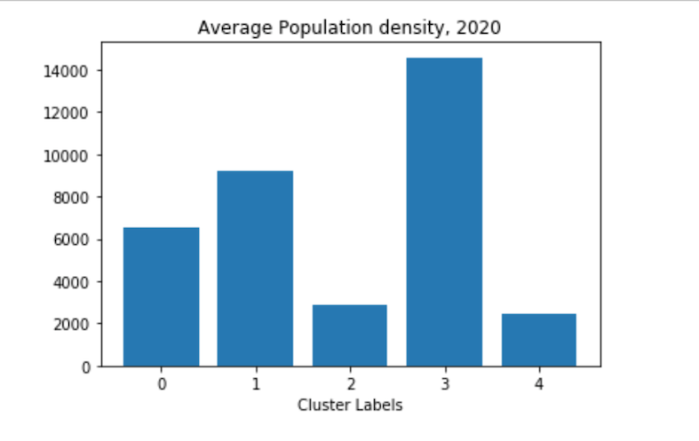
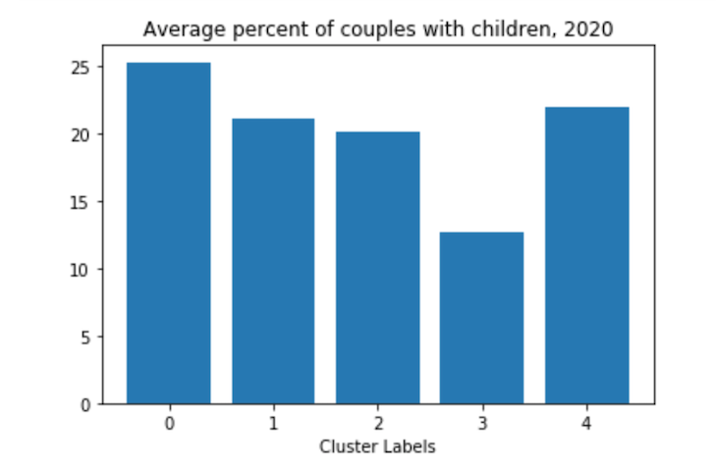
DIScussion
Recommended clusters for families with children:
Cluster 0: Suburbs
Cluster 1: Residential
Cluster 4: Harbor
Additional data related to population confirms these clusters would be suitable as the average % of population and density is lower and also the average % of couples with children is higher in these clusters.

Slide 8
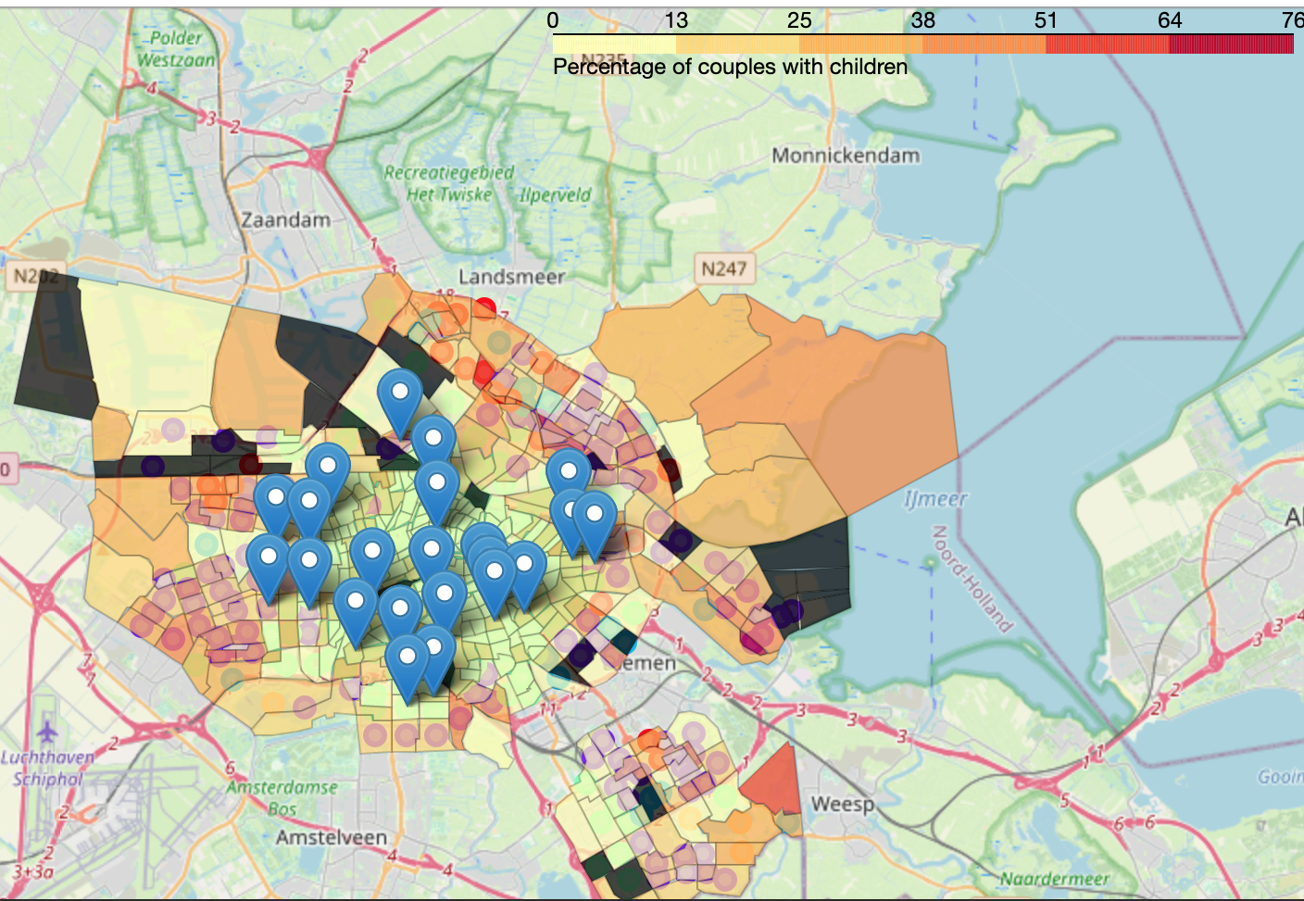
CONCLUSION
Final decision will be made based on specific characteristics of neighborhoods and their locations in the recommended clusters, other aspects like proximity to schools, parks, real estate prices or other socio/economic factors of each neighborhood should be considered.
Flagged popular neighborhoods in Cluster 1 can be chosen or as well avoided depends on price preference.

Slide 9
References and acknowledgment
Full report describing the project available on my Github
iPython Notebook with the project available on my Github
Coursera Capstone : Segmenting and Clustering Neighborhoods in Toronto
Official Amsterdam Municipality website
Wikipedia Amsterdam’s Boroughs: https://en.wikipedia.org/wiki/Boroughs_of_Amsterdam
Best neighborhoods in Amsterdam , https://dutchreview.com/expat/moving/amsterdam-neighbourhoods/
Foursquare API
Amsterdam Geojson file from Municipality API
Big thank you to the IBM and Coursera for offering the IBM Data Science Professional Certification!

